Slide 1
Security in Distributed Systems
Security threats in isolated systems
Assumption: Isolated systems are secure
Security Mechanism: Protect from physical break-in
Security in networked systems within an administrative domain but isolated from Internet
Identity Assumption:
Whenever a program attempts some action, we can easily identify a person to whom that action can be attributed, and it is safe to assume that that person intends the action to be taken.
Optimistic Assumption about Trojan Horse Attack
Users are responsible for actions of their programs
Mechanisms:
Cryptographic Password
Authorized users with different privilege levels

Slide 2
KERBEROS –
What is Kerberos ??
INetwork Authentication Protocol
t provides for _strong_ authentication for client-server applications.
Uses secret-key cryptography to provide this strong authentication.
What is authentication ??
Authentication is the verification of the identity of an involved party and the integrity of the data that the involved party generates.
What is Cryptography ?
Cryptography refers to the techniques employed to distort data into seemingly intelligible gibberish in the view of an intruder who doesn’t have the knowledge to interpret the gibberish.
Kerberos uses the Data Encryption Std. (DES) to implement encryption.

Slide 3
Why Kerberos ???
Authentication is a key feature in multi-user system
divide up resources w/ capabilities between many users
restrict user’s access to resources.
typical authentication mechanism – passwords.
“Authentication by assertion” requires honest user !!??!
-Berkeley’s rlogin daemon is a prime example.
But regular password authentication is useless in the face of a computer network (as in the Internet)
systems crackers (hacker) can easily intercept these passwords while on the wire.

Slide 4
Surely “firewalling” is the answer for network security!!
Assumes “bad guys” are on the outside….while the really damaging ones happen from the inside !!
Restrict how users use the Internet ….
Simply a less extreme eg of dictum –
“There’s nothing more secure than a computer that is not connected to the network –and powered off !!!!”
This is simply not acceptable in the real world !!
Kerberos grew out a need to find a solution to these network security problems.

Slide 5
KERBEROS MODEL
Kerberos is based on the Secret-Key Distribution Model that was originally developed by Needham & Schroeder.
-keys are the basis of authentication in Kerberos
-typically a short sequence of bytes.
-used to both encrypt & decrypt
Encryption => plainTxt + Encryption key = cipherTxt
Decryption => cipherTxt + Decryption key = plainTxt
Encryption Key – identical to – Decryption Key (in Conventional Crypto).
Kerb v5 uses Public Key Crypto where Enc Key (!identical ) Dec Key

Slide 6
Kerberos essentially works in the same way !!!
Steps :
An user requests use of a network service
Service wants assurance that user is who he says he is.
User presents a ticket that is issued to it by a Kerberos Authentication Server(AS) – think DMV.
If the ticket is valid, service is granted.
The tickets must be unequivocally linked to the user
Ticket demonstrates that the bearer knows something that only its intended user would know ( a passwd ?? )
Ticket must obviously be safeguarded against all attacks.

Slide 7
Functions of Kerberos :
Authentication
Integrity – Is the assurance that the data received is the same as generated.
Confidentiality – is the protection of info from disclosure to those not intended to receive it.
Authorization – is the process by which one determines whether a principal is allowed to perform an operation. Authorization is done usually after principal has been authenticated or based on authenticated stmts by others.
Terms :
Principal – is the party whose identity is verified.
Verifier – is the party who demands assurance of the principal’s identity.
Ticket – a certificate issued by an AS encrypted using the Server Key
Ticket = Rnd Session Key + Name of Principal + Expiration Time +others.The rnd session key is used for authenticating the principal to the Verifier.

Slide 8
How does Kerberos work?
Instead of client sending password to application server:
Request Ticket from authentication server
Ticket and encrypted request sent to application server
How to request tickets without repeatedly sending credentials?
Ticket granting ticket (TGT)

Slide 9
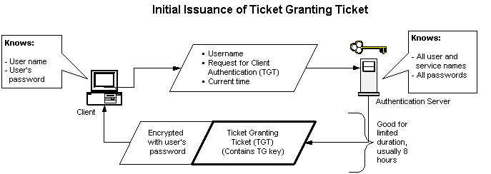
How does Kerberos work?: Ticket Granting Tickets

Slide 10
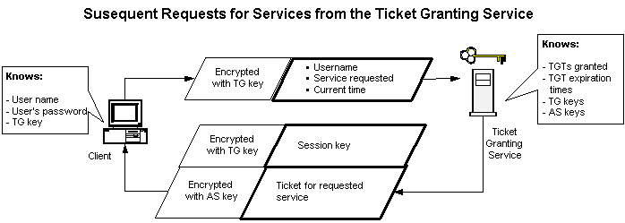
How does Kerberos work?: Ticket Granting Tickets

Slide 11
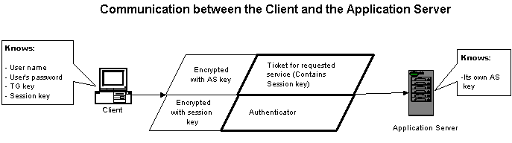
How does Kerberos work?: The Application Server

Slide 12
Applications :
Kerberos-aware applications are called Kerberized.
Kerberizing is the most difficult part of installing krb.
Some krb’zed applications are –
Berkeley R-commands, telnet, POP, USC’s Win2000 network (!?!)
GSS-API – Generic Security Services-API
-std programming interface which is authentication mechanism indep.

Slide 13
Submitted by:
Parv gupta(A2305311024)
Geetika jain(A2305311017)
Nishant chauhan(A2305311058)
Sukanya roy(A23053110)

